Slide 1
Cyber Attacks & Defense
Course Intro & Account Registration
Dr. Yeongjin Jang

Slide 2
Course Description
Goal: Learn how cyber attacks work at the assembly level
Understand how attacks work to counter them
Lecture & Exercise
Learn high-level concepts of attacks in the lecture
Practice attacks with exercise
Topics
Reverse engineering
Binary analysis
Exploit writing
Patching vulnerabilities
etc.

Slide 3
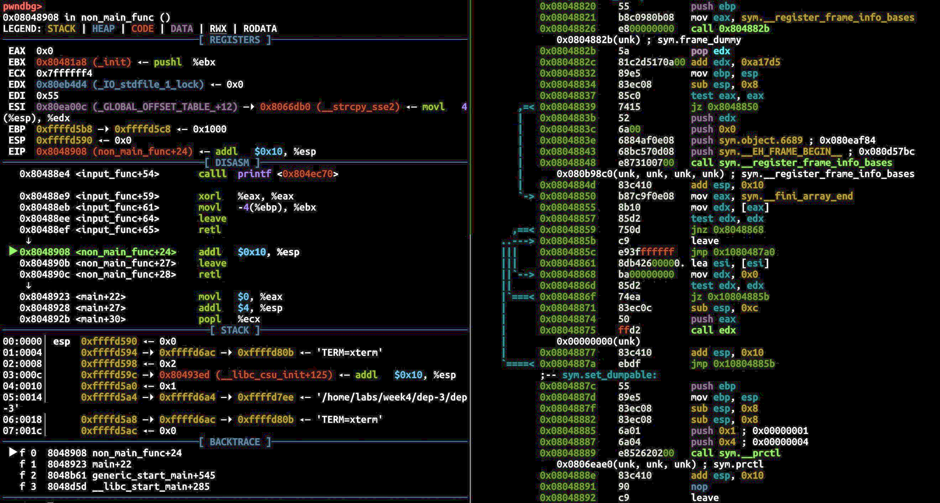
Course Description

Slide 4
Course Description
Goal: Learn how cyber attacks work at the assembly level
Understand how attacks work to counter them
Lecture & Exercise
Learn high-level concepts of attacks in the lecture
Practice attacks with exercise
Topics
Reverse engineering
Binary analysis
Exploit writing
Patching vulnerabilities
etc.

Slide 5
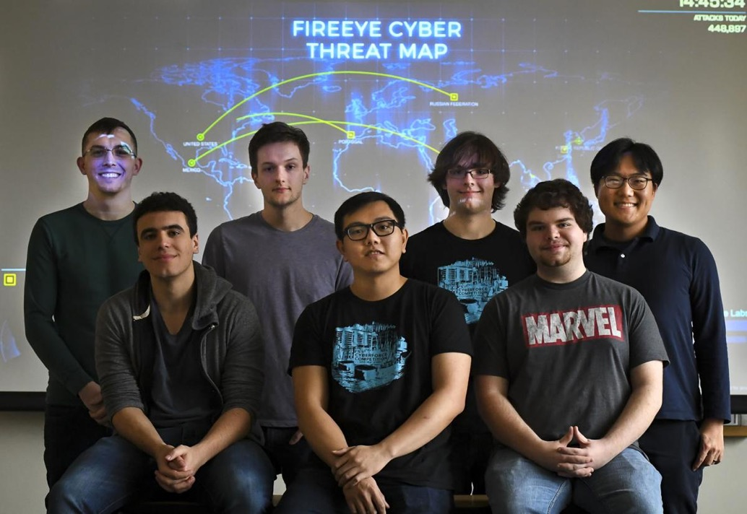
Goal #2
Participate in Cybersecurity Competitions

Slide 6
Course Description
Website: https://cand.unexploitable.systems
Instructor: Dr. Yeongjin Jang (yeongjin.jang@oregonstate.edu)
TA: Andrew Quach (quachand@oregonstate.edu)
Scoring: https://ctf.unexploitable.systems/
Discord: https://discord.gg/86k889scJ4
Assignment server: ssh vm-ctf1.eecs.oregonstate.edu
Please connect to OSU VPN or the flip server if you are not on the campus network

Slide 7
Course Structure
10 weeks schedule
Intro – rev eng. and shellcode writing (week 1-3)
Exploit writing (Week 3-8)
Advanced topics (Week 9-10)
~50 min lecture & tutorials
~1 hr interactive exercise + Q&A
Please ask many questions!!!
1.5 hr / week office hour with me (and more unofficial OH on Discord)
TA office hour on Discord

Slide 8
Meeting Time
Lecture & in-class exercise
BEXL 415 16:00 – 17:50 (4:00 pm – 5:50 pm)
https://cand.unexploitable.systems/cal.html
Office hour (Via Zoom)
Wed 5:30pm – 7:00pm (Interactive Q&A)

Slide 9
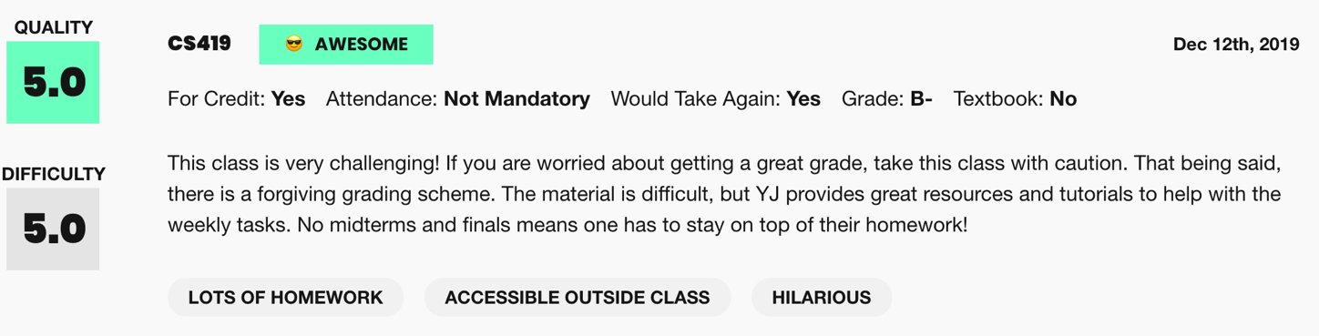
Grading
100% lab assignment, no midterm / final exam
Example grading scheme (graduate students will have a higher bar, +5%)
A: 85% <= Score <= 100%
B: 75% <= Score < 85%
C: 65% <= Score < 75%
D: 50% <= Score < 65%
F: Score <= 50% or misses an entire week’s assignment

Slide 10
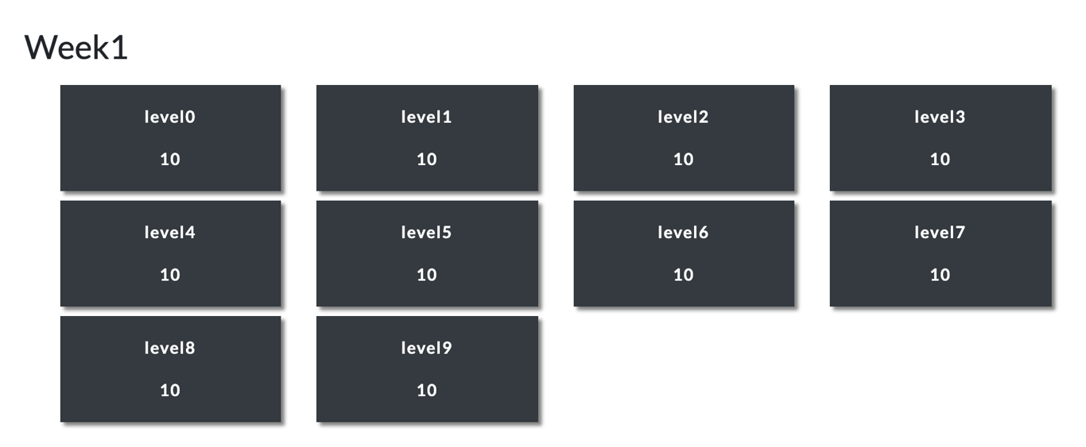
Assignment
~10 challenges per each week
Class exercise will cover 2~3 challenges via tutorials

Slide 11
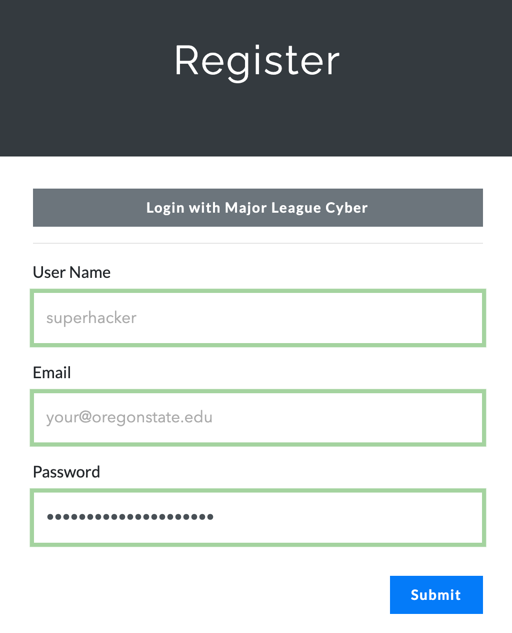
Scoring System
https://ctf.unexploitable.systems/
Register yourself using @oregonstate.edu e-mail address
Use your preferred pseudonym for “User Name”
You need to click the link in the confirmation e-mail to login

Slide 12
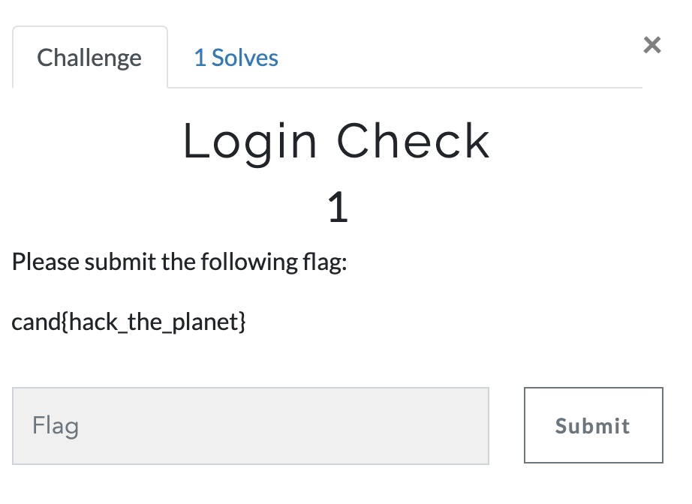
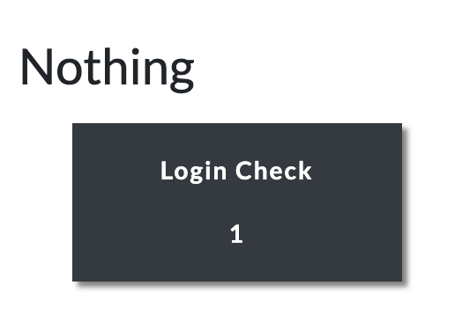
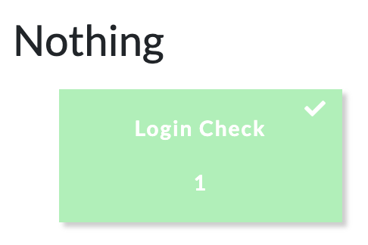
After Login, Please Submit the FLAG
Login Check

Slide 13
Assignment Rules
DO NOT SHARE YOUR CODE WITH OTHER STUDENTS
You are encouraged to discuss with others about the assignments but do not ask/give the code to the others
Do not copy other students’ code
Do not publish your code online
You will be asked to submit a simple write-up for the assignment
Starting from challenges in week 2 (NO WRITEUP for week 1 challenges)
Describe how you solve the challenge
Do not copy other students’ write-up
Mention your collaborators in the write-up
Do not publish your write-up online

Slide 14
Assignment Rules
All assignment will have fixed due dates
Late submissions will get 50% of pts, allowed up to 7 days of delay
Please refer the Code of Student Conduct
http://studentlife.oregonstate.edu/sites/studentlife.oregonstate.edu/files/final_code_of_student_conduct_updated_1_8_18.pdf
Plagiarism will be punished
E.g., getting F or zero point for an entire week’s assignment
Please submit at least one challenge per each week
Otherwise, you will get F
Please read full rules here
https://cand.unexploitable.systems/info.html

Slide 15
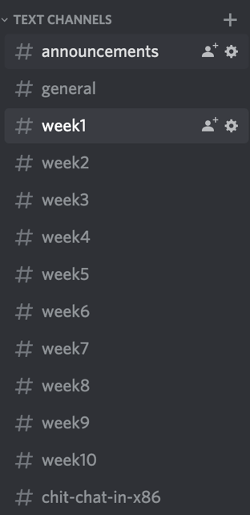
Tips to Solving Assignments
Study in a group (do discussions!)
Use Discord, ask for help!
Follow the class and tutorial videos
Tackle challenges “in-order”
Ask questions
Understand your time budget
Learn basic tools (e.g., gdb, pwntools, Python, assembly, editors, etc.)

Slide 16
Ethical Hacking
DO NOT ATTACK SYSTEMS OTHER THAN VM-CTF{1,2,3}
If you found vulnerabilities in vm-ctf* or ctf.unexploitable.systems
Please let me know; I reserved some extra credits for this
Attack your own and isolated environment
Your home directory
Challenge server
DO NOT DOS the server…
Easy trick: while(1) fork(); ← Don’t do this…
Follow the law and regulations
https://www.wklaw.com/computer-intrusion-under-federal-law/
Bug bounty policies

Slide 17
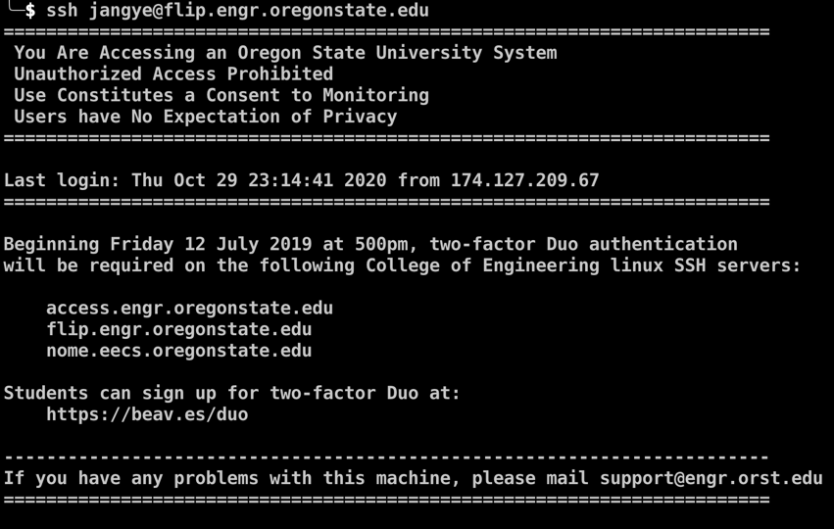
ToDo: Register to Servers
Login to Flip
ssh flip.engr.oregonstate.edu
Or use PuTTY/MobaXterm, etc., to get on the flip server

Slide 18
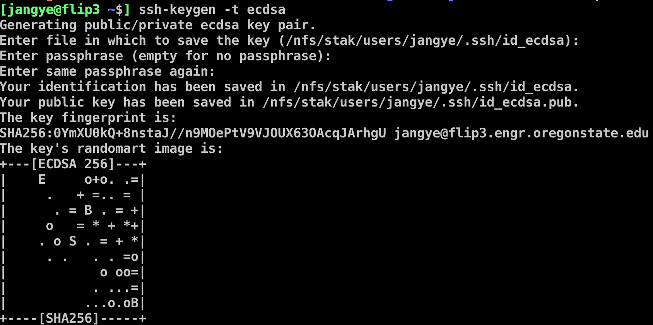
ToDo: Register to Servers
Create a key (on flip or other UNIX-like systems)
ssh-keygen –t ecdsa
You may reuse existing key if you have any…

Slide 19
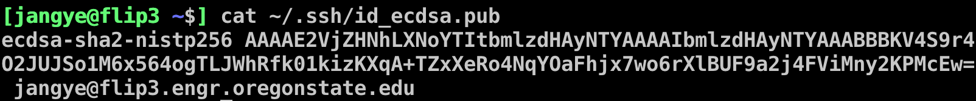
ToDo: Register to Servers
Get your public key
Copy the entire text from “ecdsa” to “.edu”

Slide 20
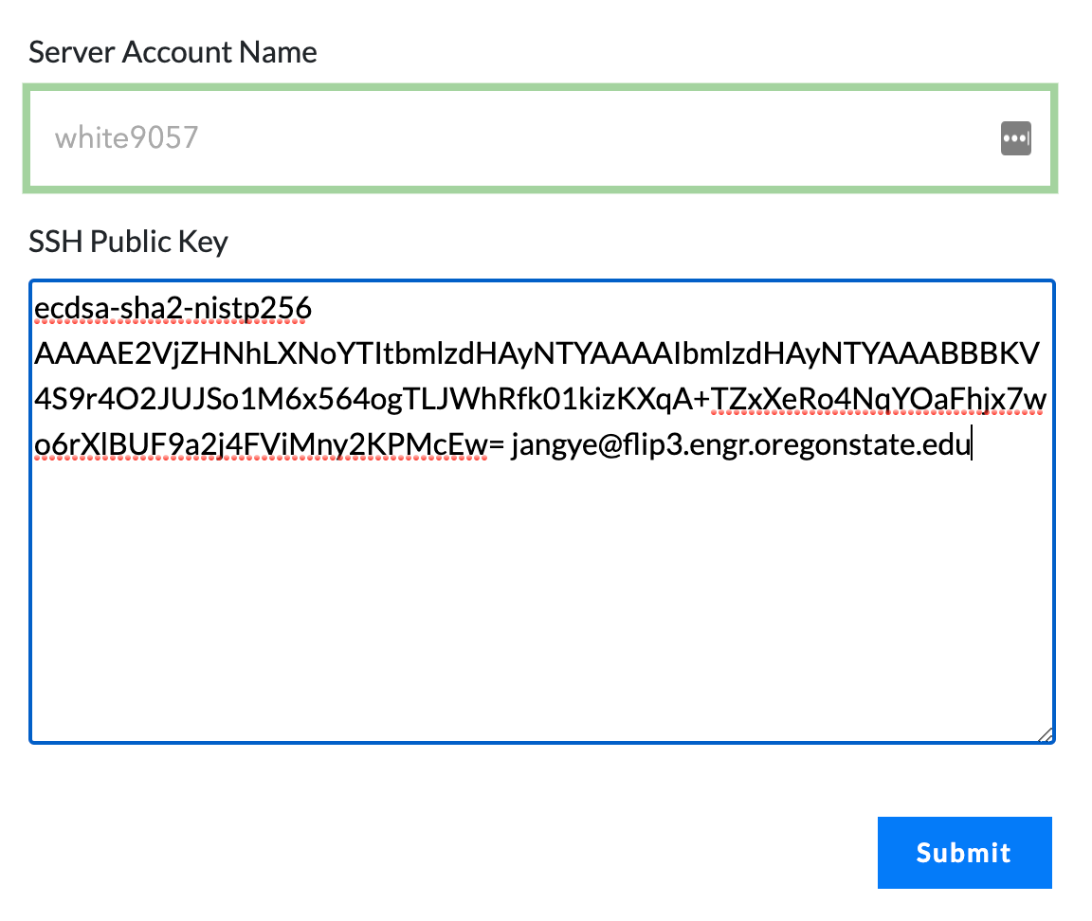
ToDo: Register Your Public Key
Go to ‘Account’ menu at the ctf website
https://ctf.unexploitable.systems/register_account

Slide 21
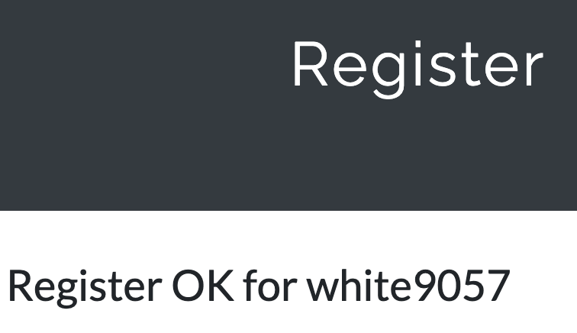
Server Account Creation
Wait few seconds after clicking ‘Submit’
After getting ‘Register OK’
Try
ssh username@vm-ctf1.eecs.oregonstate.edu
E.g., ssh white9057@vm-ctf1.eecs.oregonstate.edu

Slide 22
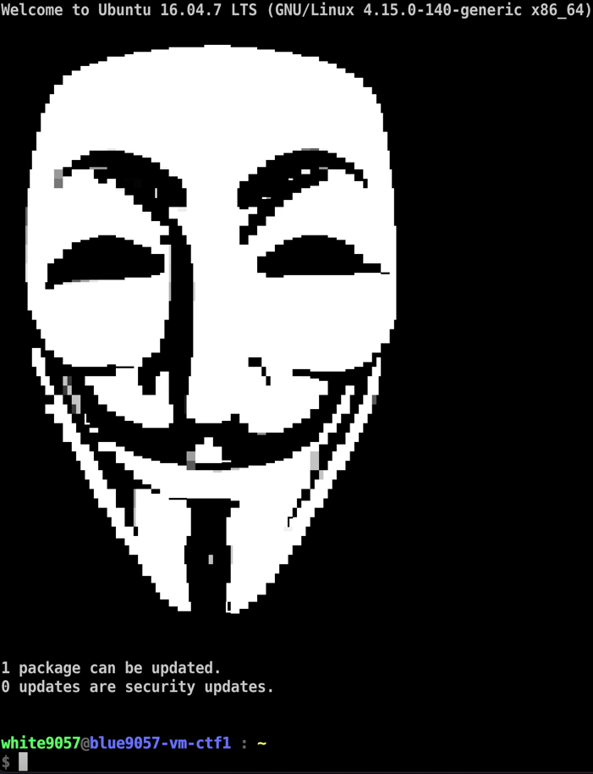
Server Account Creation

Slide 23
Week 1 – Basic Reverse Engieering
Understanding assembly code in a binary program
Translating x86 assembly into a readable C-like pseudocode
Intel assembly
GDB

Slide 24
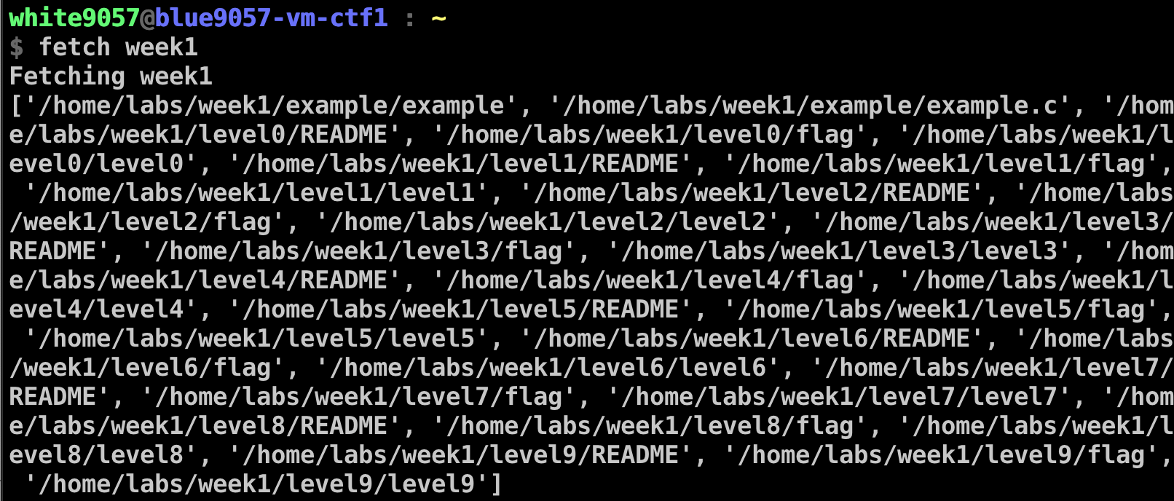
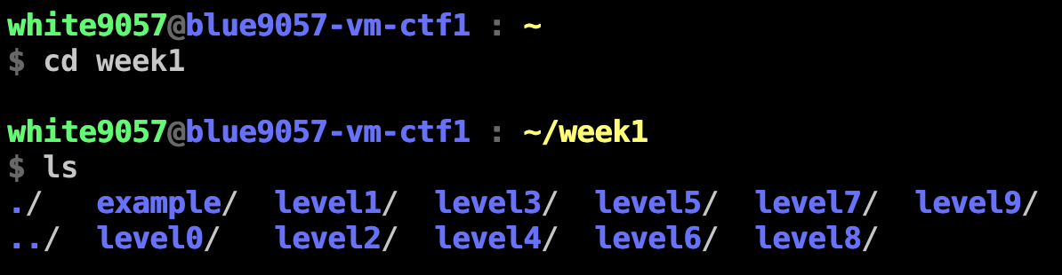
How to Get Challenges?
Run `fetch week1`

Slide 25
Assignment: Week-1
Please solve challenges in the /home/labs/week1 directory
Objective: run spawn_a_shell() function to read flags!
Challenges are at:
vm-ctf1.eecs.oregonstate.edu
Read the flags and submit them
https://ctf.unexploitable.systems
Due: 10/5 4:00pm

Slide 26
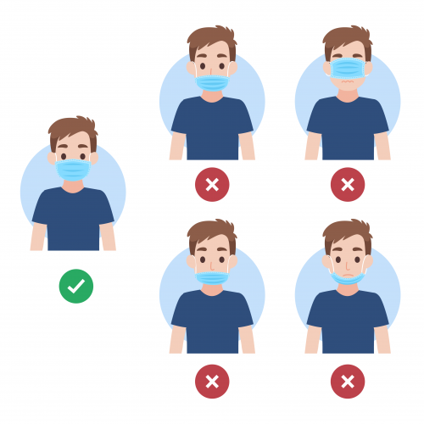
COVID-19 Class Safety Policy
Please apply face covering properly while you are in the classroom
If there is anyone who did not wear their face cover properly, we cannot deliver in-person lecture (for safety reasons)
In case face covering prevents you from learning efficiently from this class, then please join the class via Zoom link or use YouTube videos.
Thank you all for your effort making the class safe

